Slide 1
Resume
https://www.indeed.com/career-advice/interviewing/job-interview-etiquette
https://careers.uiowa.edu/careerbuzz/201509/10-things-do-right-interview
D. F. Beer and D. A. McMurrey, A Guide to Writing as an Engineer, 4th ed. New York: Wiley Publications, 2014.

Slide 2
Being Effective in ANY Role
There are three basic components to any profession…
Technical Skills
Business Skills / Job Knowledge
Human Skills

Slide 3
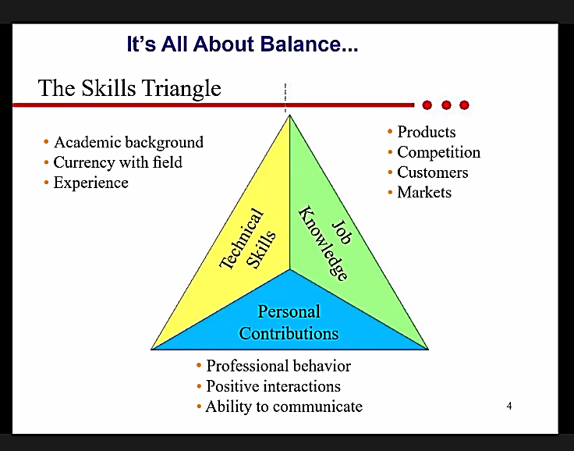

Slide 4
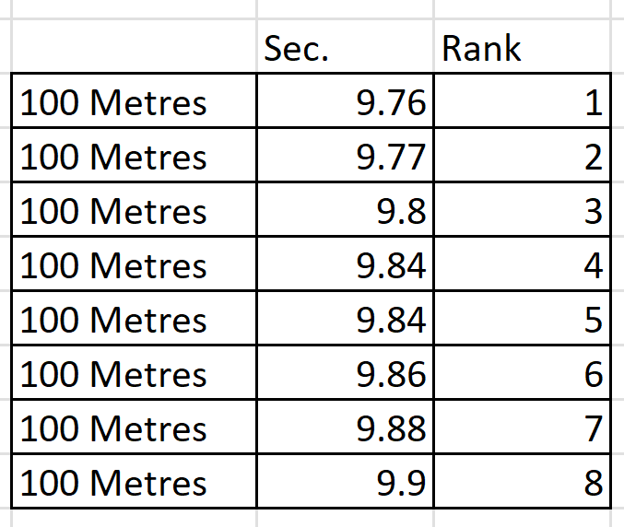
The 100 meters sprint race records

Slide 5
Résumés
Three Points:
Emphasis: Select just a few major points of emphasis from your professional life.
Length: Only one page.
Arrangement: Pleasing to the eye and easy to scan.

Slide 6
Writing to Get an Engineering Job
The resume is your main vehicle for presenting yourself to a potential employer.
The central question to ask in preparing your resume is, ‘‘If you were an employer, would you want to read this resume?’’ . . .
Visual impact and appearance are extremely important.
Reference:
Raymond Landis, Studying Engineering: A Road Map to a Rewarding Career, 2nd ed. (Los Angeles, CA: Discovery Press, 2000), p. 223.

Slide 7
Writing to Get an Engineering Job
A resume is a summary of your professional experience, education, and other background relevant to the employment opportunity you are seeking.
The key to writing an effective resume – one that highlights your best qualifications – is a design that can be scanned in about 20 to 30 seconds.

Slide 8
Writing to Get an Engineering Job
Developing a resume is not a one-time effort. Consider it a work in progress.
Resume is not a permanent record of your background, which you updated only infrequently.
You may have to revise it for every new employment opportunity you seek;
You must update it at every accomplishment, milestone, or new phase in your career.
You have to redesign your resume for every new employment opportunity.

Slide 9
Writing to Get an Engineering Job
Keep a working draft of your resume always at hand (a digital file or a hard copy)
Scribble notes whenever your career takes a new turn.
Compile a comprehensive list of your education, experience, project management activities, training, skills, and licenses, and then select the most relevant items for your résumé.

Slide 10
Design Components
The design of a resume is certainly important to success in an employment search.
But a resume can’t do it alone
Many other elements have to be present such as connections, timing, need, and of course your actual qualifications.

Slide 11
Design Components
Chronological or Functional Organization.
One of the first issues in resume design is whether to divide your background information chronologically or functionally.

Slide 12
Alex Morgan
alex.morgan@email.com | (555) 123-4567 | Riverside, CA | linkedin.com/in/alexmorgan
Professional Summary
Results-driven Electrical Engineering graduate with strong experience in embedded systems, circuit design, and project management. Proven ability to lead technical teams, deliver projects on time, and communicate complex ideas effectively.
Education
University of California, Riverside — B.S. in Electrical Engineering Graduated: June 2025 Relevant Coursework: Signals and Systems, Digital Design, Embedded Systems, Control Systems
Professional Experience
Electrical Engineering Intern — TechCore Solutions, Irvine, CA (June 2024 – Sept 2024)
- Designed and tested PCB layouts using Altium Designer - Assisted in debugging embedded systems using C/C++ - Collaborated with cross-functional teams to improve product efficiency by 15%
Engineering Assistant — UCR Research Lab, Riverside, CA (Sept 2023 – June 2024)
- Supported research in sensor networks and data acquisition systems - Conducted data analysis using MATLAB and Python - Prepared technical documentation and reports
Projects
Smart Home Automation System (2024)
- Developed IoT-based system using Arduino and Raspberry Pi - Integrated mobile app for remote monitoring and control - Improved energy efficiency through automated scheduling
Autonomous Line-Following Robot (2023)
- Designed control algorithms and sensor integration - Programmed microcontroller using C - Achieved 98% accuracy in path tracking
Skills
Programming: C, C++, Python, MATLAB Tools: Altium Designer, LTspice, SolidWorks Other: Project Management, Technical Writing, Data Analysis
Certifications
Fundamentals of Engineering (FE) — Expected 2025 Certified
Chronological
Organization

Slide 13
Chronological
Organization

Slide 14
Alex Morgan
alex.morgan@email.com | (555) 123-4567 | Riverside, CA | linkedin.com/in/alexmorgan
Professional Summary
Electrical Engineering graduate with strong competencies in embedded systems, circuit design, and technical project execution. Demonstrated ability to apply engineering principles in practical settings and communicate technical results effectively.
Core Competencies
Embedded Systems & Programming
- Developed and debugged embedded applications using C/C++ - Implemented microcontroller-based systems (Arduino, Raspberry Pi)
Circuit Design & Analysis
- Designed and tested PCB layouts using Altium Designer - Performed simulations using LTspice
Data Analysis & Technical Documentation
- Analyzed experimental data using MATLAB and Python - Produced structured technical reports and documentation
Project Management & Teamwork
- Coordinated with cross-functional teams to meet project deadlines - Managed small-scale engineering projects and lab tasks
Selected Projects
Smart Home Automation System
- Developed IoT-based system with remote monitoring - Improved energy efficiency through automation
Autonomous Line-Following Robot
- Designed control algorithms and sensor systems - Achieved high accuracy in navigation
Professional Experience
Electrical Engineering Intern — TechCore Solutions, Irvine, CA (June 2024 – Sept 2024)
Engineering Assistant — UCR Research Lab, Riverside, CA (Sept 2023 – June 2024)
Education
University of California, Riverside — B.S. in Electrical Engineering, June 2025
Additional Information
Programming: C, C++, Python, MATLAB Tools: Altium Designer, LTspice, SolidWorks Certifications: FE (Expected), CLAD
Functional Organization

Slide 16
Keywords for Resumes
Types of Keywords for Resumes
What keywords should you use on your resume? Here's a quick starting point to begin considering the types of keywords to include on your resume:
Industry-Specific Skills - Bookkeeping, product launch, and proposal writing
Soft Skills - Problem solving, communication, sales, and team management
Hardware and Software Used for the Job - Dreamweaver, SQL, and VOIP
Job Titles - UX Designer, Business Development Manager, and Full stack Developer
Training and Certification - Six Sigma, Project Management, and ITIL
Education - MBA, PhD, and BS
Industry Jargon - Asset management, A/B Editing, and digital video editing workflow
Impressive Terms - Fortune 500 and top salesman
Company Names - Big name companies are sometimes used when finding applicants for top positions.
Locations - Zip codes, city or state names used to narrow down searches to a geographic location
https://business.tutsplus.com/tutorials/how-to-use-resume-keywords-and-phrases--cms-27311

Slide 17
Design Components
The chronological approach divides your background into:
Education
Work experience, and possibly military

Slide 18
Design Components
The chronological approach:
Strengths:
Shows your work history
Your responsibilities and projects for each organization
Shows where you studied and what you studied

Slide 19
Design Components
The chronological approach:
Weakness:
Information is spread across work and education sections
Does not give a capsule picture of your key qualifications and your key strengths

Slide 20
Design Components
The chronological approach:
A solution for the Weakness of Chronological approach:
Add a highlights section
Adding a “Highlights” (or “Key Highlights” / “Key Achievements”) section at the top of a chronological résumé is not only common, but highly recommended, especially for:
Engineering and technical roles
Entry-level candidates (to surface strengths quickly)
Competitive job applications where recruiters skim in seconds

Slide 21
Highlights Section or
Summary of Education
Highlights of Experience,
Synopsis of Qualifications,
Professional Expertise,
A career highlights/qualifications section of a ​resume is an optional customized section of a resume that lists key achievements, skills, traits, and experience relevant to the position for which you are applying. It is also known as a resume summary.

Slide 22
Alex Morgan
alex.morgan@email.com | (555) 123-4567 | Riverside, CA | linkedin.com/in/alexmorgan
Highlights
- Designed and tested PCB layouts, improving system efficiency by 15% - Developed IoT-based smart home system integrating Arduino and Raspberry Pi - Strong programming skills in C, C++, Python, and MATLAB - Proven experience in technical documentation and data analysis - Effective team collaborator with project management experience
Professional Summary
Results-driven Electrical Engineering graduate with experience in embedded systems, circuit design, and project execution. Skilled in translating theoretical concepts into practical applications and delivering projects efficiently.
Education
University of California, Riverside — B.S. in Electrical Engineering Graduated: June 2025
Professional Experience
Electrical Engineering Intern — TechCore Solutions, Irvine, CA (June 2024 – Sept 2024)
- Designed and tested PCB layouts using Altium Designer - Assisted in debugging embedded systems using C/C++ - Collaborated with teams to improve product efficiency
Engineering Assistant — UCR Research Lab, Riverside, CA (Sept 2023 – June 2024)
- Supported research in sensor networks - Conducted data analysis using MATLAB and Python - Prepared technical documentation
Projects
Smart Home Automation System
- Developed IoT-based system for automation and monitoring
Autonomous Line-Following Robot
- Designed control algorithms and sensor integration
Skills
Programming: C, C++, Python, MATLAB Tools: Altium Designer, LTspice, SolidWorks Other: Project Management, Technical Writing

Slide 23
Highlights Section
For professionals who are several years into their careers.
The highlights section provides a neat bulleted list of your key accomplishments, key areas of expertise, key education and training, and so on.

Slide 24
Design Components
The functional approach
Divides your background into groups of related education, training, and experience.
Example: Courses you have taken in college on project management, attended professional seminars on the subject, taken lead roles in the management of several projects, and maybe even won an award for your management of a project.
All of this could be summarized under the heading ‘‘Project Management’’ in a functionally organized resume

Slide 25
Design Components
The functional approach
Strength:
Consolidates information about each of your key qualifications,
Summarizes all relevant work experience and education for each qualification.

Slide 26
Design Components
The functional approach
Weakness:
Chronology of your career is unclear.
Solution: include a list of your experience and education (no description, just the names and dates)

Slide 27
Alex Morgan
Riverside, CA | (555) 123-4567 | alex.morgan@email.com | linkedin.com/in/alexmorgan
Highlights
- Designed and tested PCB layouts, improving system efficiency by 15% - Experience with embedded systems programming (C/C++, Arduino, Raspberry Pi) - Strong background in data analysis using MATLAB and Python - Proven ability to work in teams and deliver technical projects on time - Skilled in technical documentation and engineering communication
Career Snapshot
Experience:
Electrical Engineering Intern — TechCore Solutions, Irvine, CA (Jun 2024 – Sep 2024) Engineering Assistant — UCR Research Lab, Riverside, CA (Sep 2023 – Jun 2024)
Education:
B.S. Electrical Engineering — University of California, Riverside (2021 – 2025)
Professional Experience
Electrical Engineering Intern — TechCore Solutions, Irvine, CA (Jun 2024 – Sep 2024)
- Designed and tested PCB layouts using Altium Designer - Debugged embedded systems using C/C++ - Collaborated with teams to improve product performance by 15% - Assisted in prototype development and validation
Engineering Assistant — UCR Research Lab, Riverside, CA (Sep 2023 – Jun 2024)
- Supported research in sensor networks and data acquisition - Conducted data analysis using MATLAB and Python - Prepared technical reports and documentation - Assisted in lab setup and testing
Projects
Smart Home Automation System (2024)
- Developed IoT-based system using Arduino and Raspberry Pi - Enabled remote monitoring via mobile interface - Improved energy efficiency through automation
Autonomous Line-Following Robot (2023)
- Designed control algorithms and sensor integration - Programmed microcontroller in C - Achieved 98% tracking accuracy
Education
University of California, Riverside — B.S. Electrical Engineering (June 2025) Relevant Coursework: Signals & Systems, Embedded Systems, Digital Design, Control Systems
Skills
Programming: C, C++, Python, MATLAB Tools: Altium Designer, LTspice, SolidWorks Other: Technical Writing, Data Analysis, Project Management
Certifications
Fundamentals of Engineering (FE) — Expected 2025 Certified LabVIEW Associate Developer (CLAD

Slide 28
Design Components
Objectives Section
Describes your career and professional focus.
Indicates the type of work you want to do,
Indicates the type of position you seek, and the type of
organization you want to work for
Include an Objective Section or not?

Slide 29
Design Components
Objectives Section
Must be short, not more than two or three lines
Must be specific
Weak objectives statement: Seeking a challenging, rewarding career with a dynamic upscale company where I will have ample room for professional and personal growth.

Slide 30
Design Components
Objectives Section
Improved objectives statement: Construction engineer seeking position in HVAC design and energy calculation for residential and commercial structures.

Slide 31
Design Components
Objectives Section
Include an Objective Section or not?
It can narrow your opportunities.
It depends to the type of company and specifications of the job

Slide 32
Design Components
Memberships and Licenses.
list of professional organizations and licenses.
Specialized Equipment and Knowledge.
Itemizes technical knowledge.
For example, computer specialists may list the hardware and software they know.
Electrical engineers may list their skills in such areas as analog circuit and signal analysis as well as digital and control systems.

Slide 33
Design Components
Create sections based on your own achievements:
If you have published articles in professional journals, create a publications section.
If you’ve received honors and awards, create a section for that.
If you have received patents, list those in their own section.
If you have various security clearances, list them.
The idea is to design the resume so that it emphasizes your best and most important qualifications.

Slide 34
Where to Put These Sections in a Résumé
🔹 General Rule
• Place high-impact, job-relevant sections earlier
• Place less critical or supplementary sections later
• Keep the résumé 1 page (students) or 1–2 pages max
________________________________________
Recommended Order (Engineering / Technical Resume)
Top Section (after Highlights / Summary)
Use here ONLY if highly relevant
1. Publications (for research / academic / R&D roles)
2. Patents (very strong—can go high if applicable)
_______________________________________
Middle Section (after Experience / Projects)
Most common placement
3. Honors and Awards
• Scholarships
• Dean’s list
• Competitions
• Fellowships
________________________________________
Bottom Section (near Skills / Certifications)
Supporting information
4. Security Clearances
• ……..

Slide 35
Design Components
For the education section, here are some ideas:
• Name, location, and brief description of the educational institution
• Your major and minors, grade point average (overall and in your major)
• Major emphasis of study
• [Important courses taken with descriptions]
• Experience with technologies, equipment, and technical processes at that educational institution
• Important projects
• Awards, memberships
• Dates of enrollment and graduation

Slide 37
Tips on Writing Resumes
Include specific details about qualifications and background.
• Use strong action verbs when presenting details about qualifications and background:
designed, developed, coordinated, supervised, and so on.
• Make sure that the different sections of your resume are distinct from each other; use spacing, ruled lines, and headings.
• Present education and work experience in reverse chronological order.
• When referring to your own work, omit I. Instead of writing ‘‘I supervised a team of 12 designers . . . ,’’ write ‘‘Supervised a team of 12 designers..’’

Slide 38
Tips on Writing Resumes
• Indicate the meanings of abbreviations or acronyms.
• Use format consistently.
Use consistent margins.
Use special typography moderately.
Keep resumes as short as possible.
Force the resume to fill the pages it occupies.

Slide 39
Tips on Writing Resumes
• If your resume is more than one page, put a header on the second and following pages.
Omit details on age, marital status, sex, religion, handicaps, and other personal matters.
Don’t include a photograph of yourself.
Don’t omit normal words such as articles (a, an, the).
Avoid lengthy paragraphs.

Slide 40
Tips on Writing Resumes
• If you are at the beginning of your career as an engineer and you have less or no experience:
Cite relevant projects (both in academia and community) you’ve worked on, even if they are not ‘‘real’’ engineering.
• Describe college courses and programs you have been involved in.
Write about team projects, senior projects, or reports
• Include volunteer work that has had any trace of engineering to it. (If you’ve not done any volunteer work, get to volunteering!)
• List any organizations you have been a member of and
Describe any of their activities that have any trace of engineering to them.
• Use formatting to spread what information you have to fill out the resume page.

Slide 41
Paragraph-formatting dialog in Microsoft Word.
Use Before, After, and Line spacing to fine tune the format of your resume and to fill the page, if necessary.

Slide 42
Resume Writing Instructions for a Recent Electrical Engineering Graduate
1. Header
Include:
• Full name
• Phone number
• Email address
• LinkedIn profile (optional but recommended)
• Portfolio/GitHub (if you have one)
________________________________________
2. Professional Summary / Objective (2–3 sentences)
A short summary highlighting your degree, areas of interest, key skills, and what you're seeking.
Example:
Recent Electrical Engineering graduate with hands-on experience in circuit design, embedded systems, and MATLAB simulations. Eager to apply my skills in a dynamic engineering environment and contribute to innovative electrical solutions.
________________________________________

Slide 43
3. Education
List your most recent degree first.
Example:
Bachelor of Science in Electrical Engineering
University of XYZ, City, State
Graduation: May 2025
GPA: 3.6/4.0 (if 3.0 or above)
Relevant Coursework (optional):
• Digital Systems
• Power Electronics
• Control Systems
________________________________________
4. Skills
Include both technical and soft skills.
Examples:
• Circuit Design (OrCAD, LTSpice)
• Embedded Systems (Arduino, Raspberry Pi)
• Programming (C, Python, MATLAB)
• PCB Design (Altium, Eagle)
• Signal Processing
• Team Collaboration & Communication
________________________________________

Slide 44
5. Projects (Very Important for New Grads)
List academic or personal projects with descriptions and outcomes.
Example:
Smart Energy Meter (Senior Design Project)
Designed a microcontroller-based energy meter with real-time usage tracking and GSM communication.
• Programmed the system using C++ and Arduino IDE
• Achieved ±2% accuracy compared to commercial meters
________________________________________
6. Internships / Experience
Even part-time or lab assistant roles count.
Example:
Electrical Engineering Intern
ABC Power Solutions, City, State
June 2024 – August 2024
• Assisted in drafting electrical layouts and load calculations
• Used AutoCAD to update single-line diagrams
• Participated in site visits and equipment testing
________________________________________

Slide 45
7. Certifications (if any)
Examples:
• AutoCAD Electrical Certified Associate
• MATLAB Onramp (MathWorks)
• Coursera: Embedded Systems
________________________________________
8. Leadership / Extracurriculars (optional)
If you participated in clubs, competitions, or volunteered.
Example:
President – IEEE Student Chapter
• Organized tech talks and circuit-building workshops
• Increased club participation by 30%
8. Languages (if needed)

Slide 46
Some useful resources:
https://www.indeed.com/career-advice/resumes-cover-letters/resume-format-guide-with-examples
https://careercenter.georgetown.edu/major-career-guides/resumes-cover-letters/resume-formatting-tips/
>>>> https://careercenter.umich.edu/article/resume-resources
https://www.perkins.org/resource/step-step-guide-formatting-your-resume/

Slide 47
Cover letters and Full application letters
•
Cover letters:
You simply announce that a resume is attached,
Indicate that you are investigating an employment opportunity, and
Specify the position you seek.

Slide 48
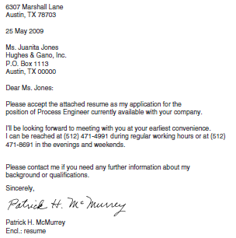
If the job advertisement asks for resumes only, you can still include this type of letter to identify the position.

Slide 49
Cover letters and Full application letters
•
Cover letters:
The cover letter is certainly easier to write, but it doesn’t do anything for you.
If a full application letter is expected, sending only a cover letter makes you seem noncommittal or even indifferent.

Slide 50
Full application letters
The function of the application letter is:
To introduce you to the prospective employer,
To state the purpose of the letter (to seek an interview),
To identify the position you are inquiring about, and
To summarize your relevant background and qualifications..

Slide 51
Full application letters
First Paragraph: Should be brief paragraph to:
State the purpose of the letter (to inquire about employment);
State how you found out about the opening, if applicable;
Say something that will catch the readers’ attention and make them want to continue reading.
Keep this first paragraph short, four lines at the maximum.

Slide 52
Full application letters
In this first paragraph, consider using one of several common tricks to catch your readers’ attention:
State something specific about your qualifications that makes you the right candidate for the position.
Cite information about the company to which you are applying.
Say something enthusiastic or energetic about the kind of work you want to do, the kind of organization you want to work for.

Slide 53
Full application letters
Middle Paragraphs. Discuss your qualifications that relate specifically to the employment you seek.
Chronological approach.
Functional approach.

Slide 54
Full application letters
Final Paragraphs.
Wrap it up!
Mention that the resume is enclosed;
Urge the prospective employer to get in touch;
Facilitate arrangements for an interview; and
Find some parting encouraging, enthusiastic comment to make, such as your strong interest in the employment, the company, the profession, and so on.

Slide 55
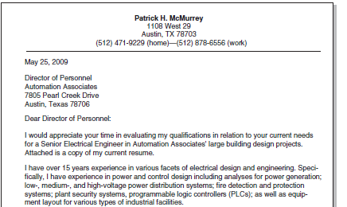

Slide 56
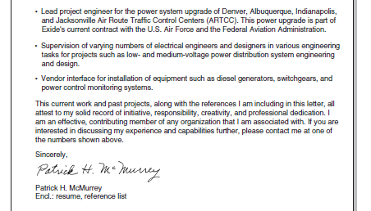

Slide 57
Format of Application Letters
Single-space the individual components (never double-space). Double-space between the components.
Do not indent the first line of paragraphs of the body text.
Carefully position your letter on the page.
Avoid dense paragraphs.

Slide 58
Tone in Application Letters
Don’t be overly formal, overly cautious.
Don’t show yourself overqualified.
Don’t write flattering stuff about the prospective employer
Don’t show yourself hungry& desperate!
Avoid the tone that says ‘‘I’ll do anything!’’

Slide 59
Tone in Application Letters
Avoid diving headlong into the details of your background and qualifications in the very first paragraph.
Get a specific name or department to which to address the letter; avoid the ‘‘To Whom It May Concern’’ syndrome.
Use standard business letter format in the application letter.
Keep the letter to one page.
Write the letter in terms of the prospective employer’s needs or interests

Slide 60
ALEXANDER REZA
Electrical Engineering Graduate Email: alex.reza@email.com | Phone: (555) 123-4567 LinkedIn: linkedin.com/in/alexreza | GitHub: github.com/alexreza
EDUCATION
B.S. in Electrical Engineering, University of California, Riverside Expected Graduation: June 2026 | GPA: 3.7
EXPERIENCE
Electrical Engineering Intern, XYZ Technologies (Summer 2025)
- Designed multi-layer PCB using Altium, reducing signal noise by 28% - Conducted circuit testing with oscilloscopes and signal generators - Automated MATLAB scripts, reducing testing time by 30%
PROJECTS
Embedded Motor Control System
- Developed C-based firmware for ARM microcontroller - Improved efficiency by 22% using optimized control algorithms - Integrated sensors and real-time feedback systems
SKILLS
Programming: C, Python, MATLAB Tools: Altium, LTspice, Oscilloscope, Multimeter Hardware: PCB Design, Embedded Systems
Being bilingual is definitely an asset, especially in engineering roles involving teamwork, documentation, or global collaboration.
Where to include it (best options)
1. Skills Section (recommended)
Most common and clean:
• Languages: English (fluent), Spanish (professional proficiency)
________________________________________
Add if highly relevant
Only if the job benefits directly:
• “Bilingual Electrical Engineering student (English/Spanish) with experience in…”
________________________________________
3. Experience Section (if used professionally)
If language skills were part of the job:
• Collaborated with Spanish-speaking technicians to troubleshoot system failures
• Prepared bilingual technical documentation for international teams

Slide 61
